Slide 1



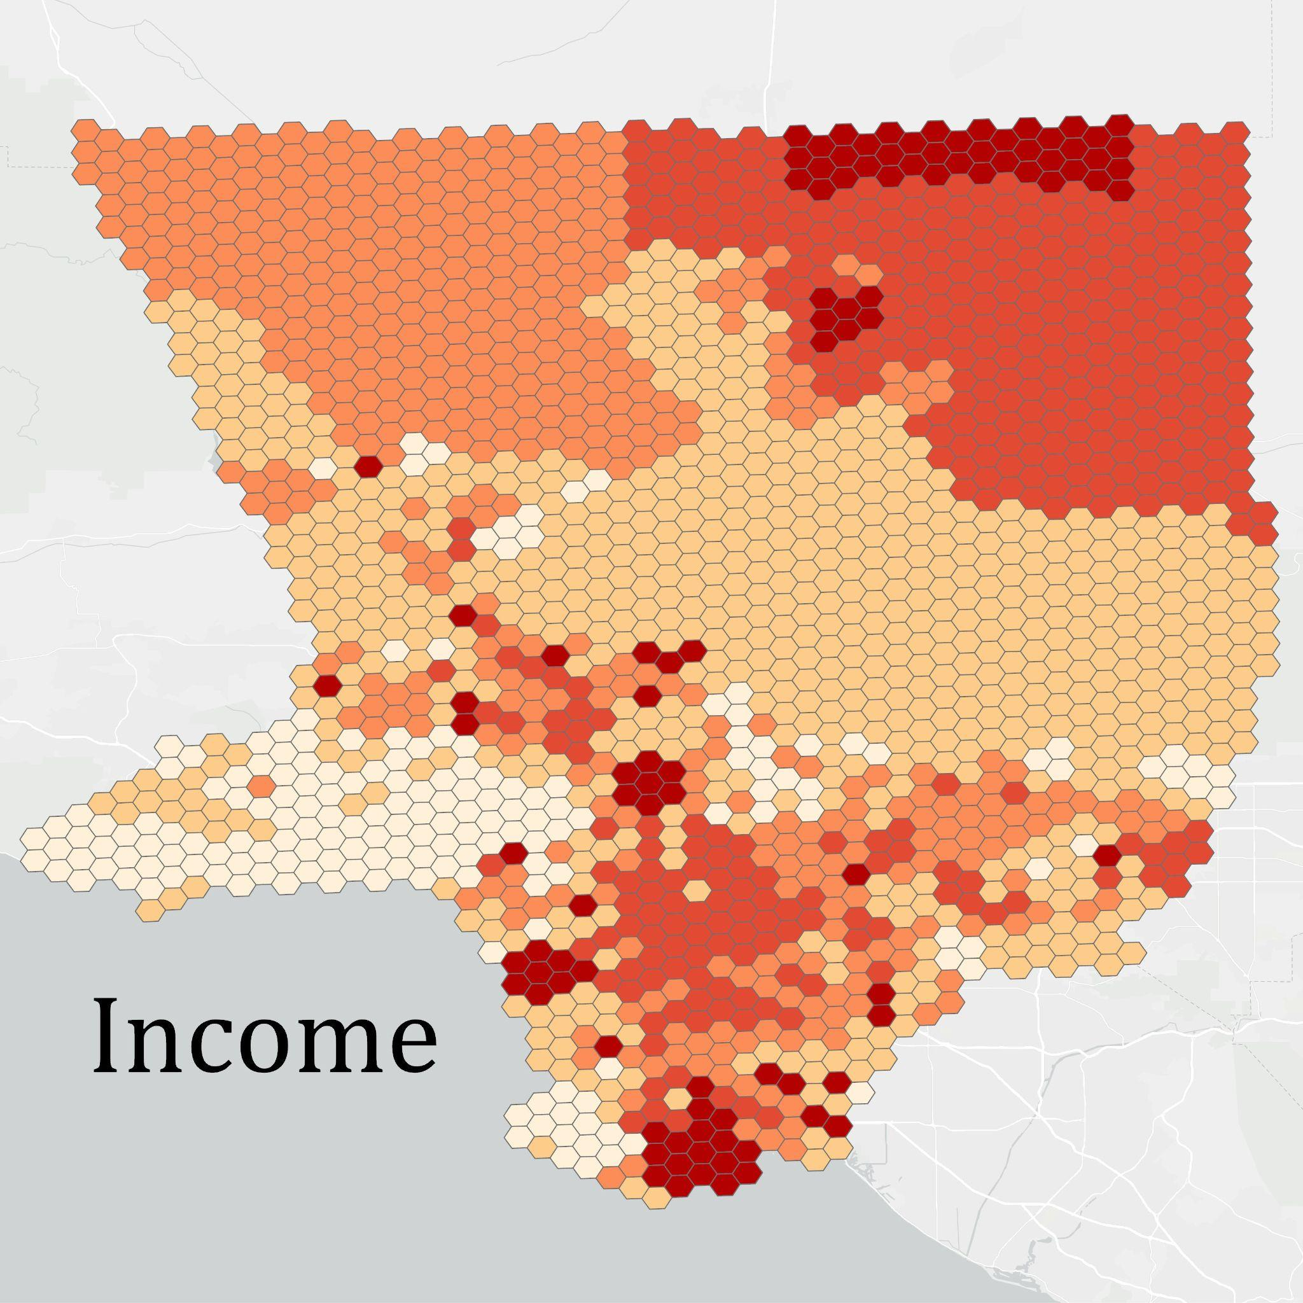
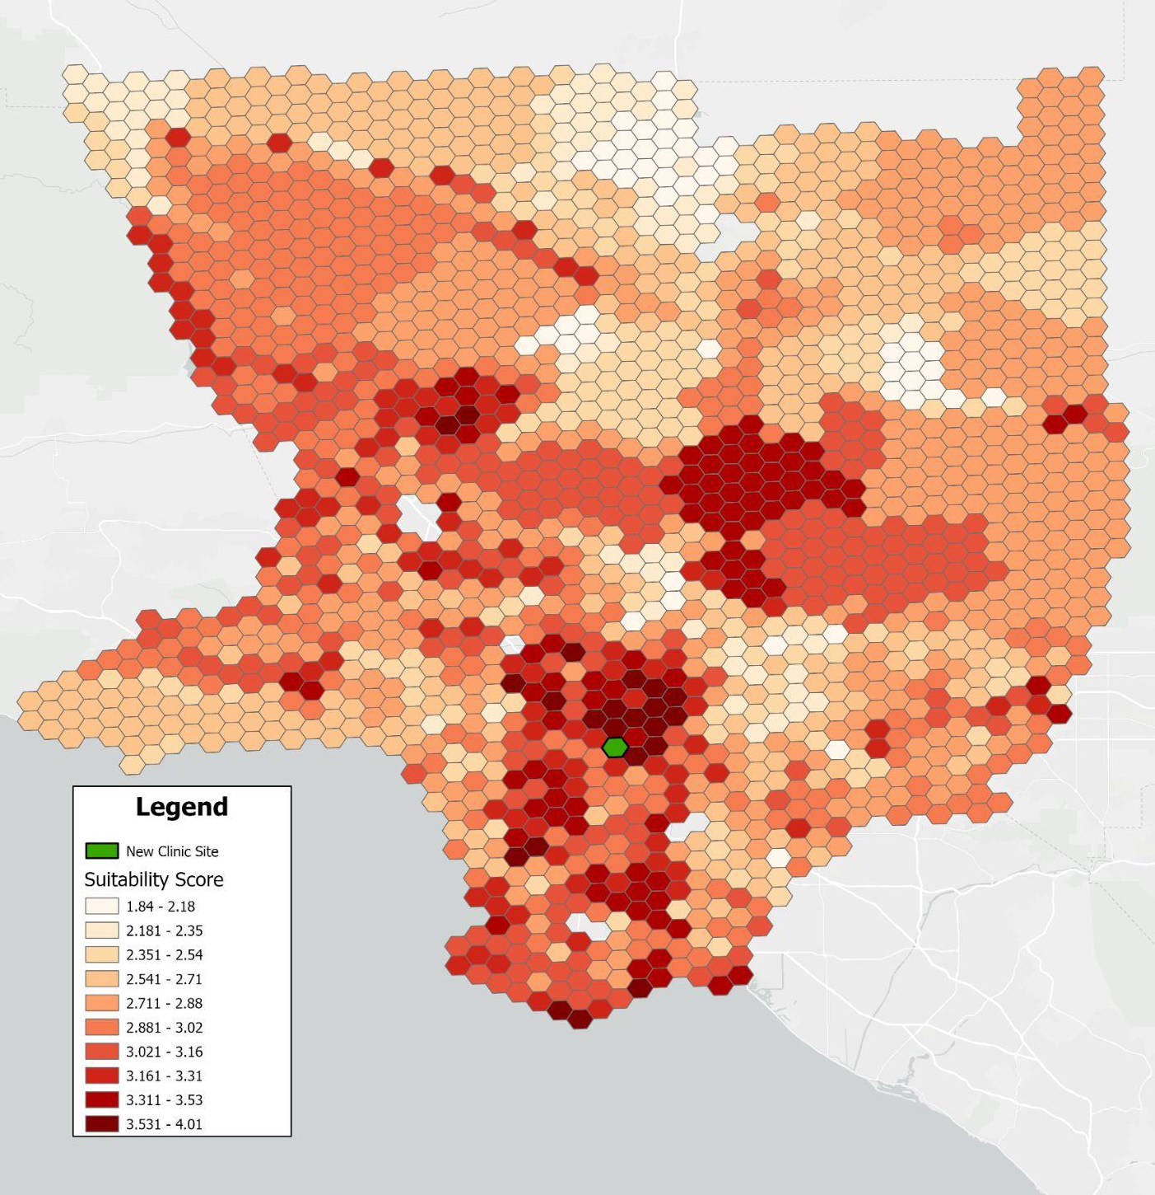
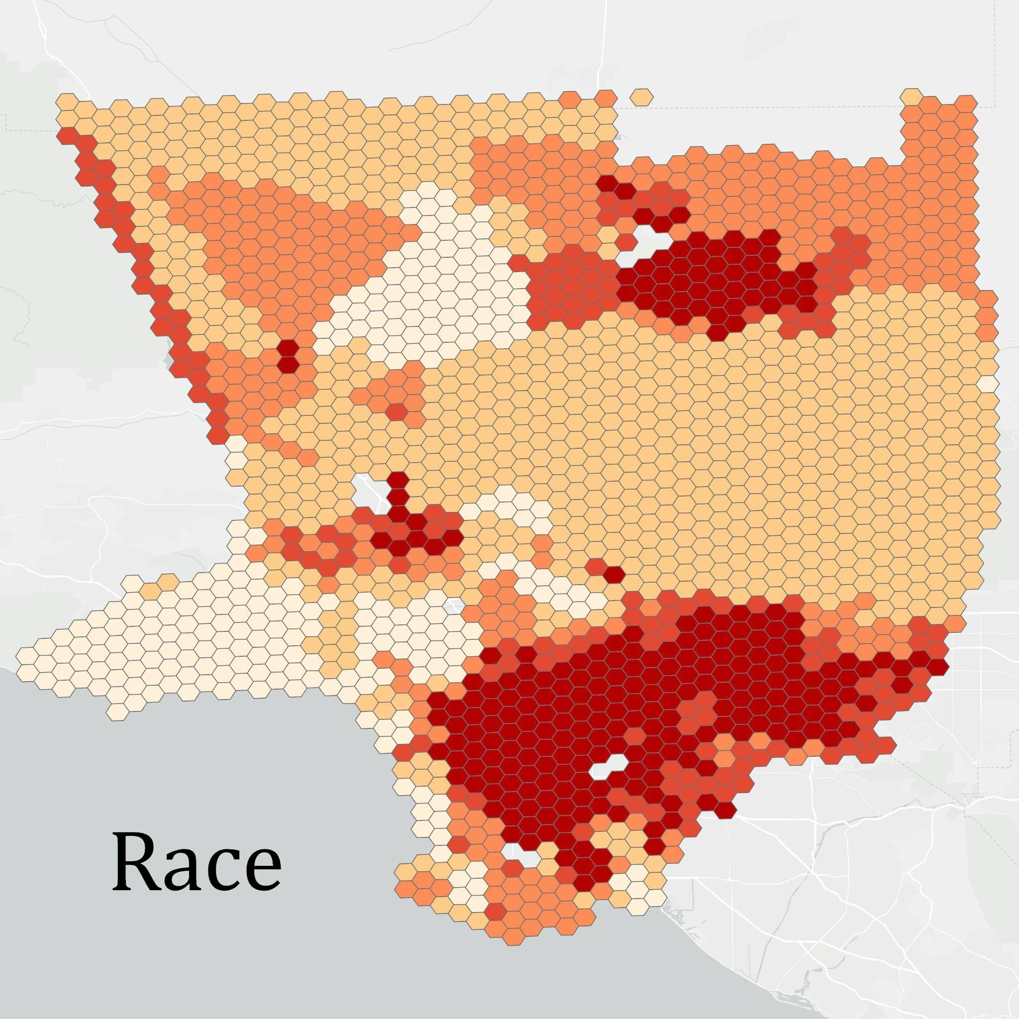
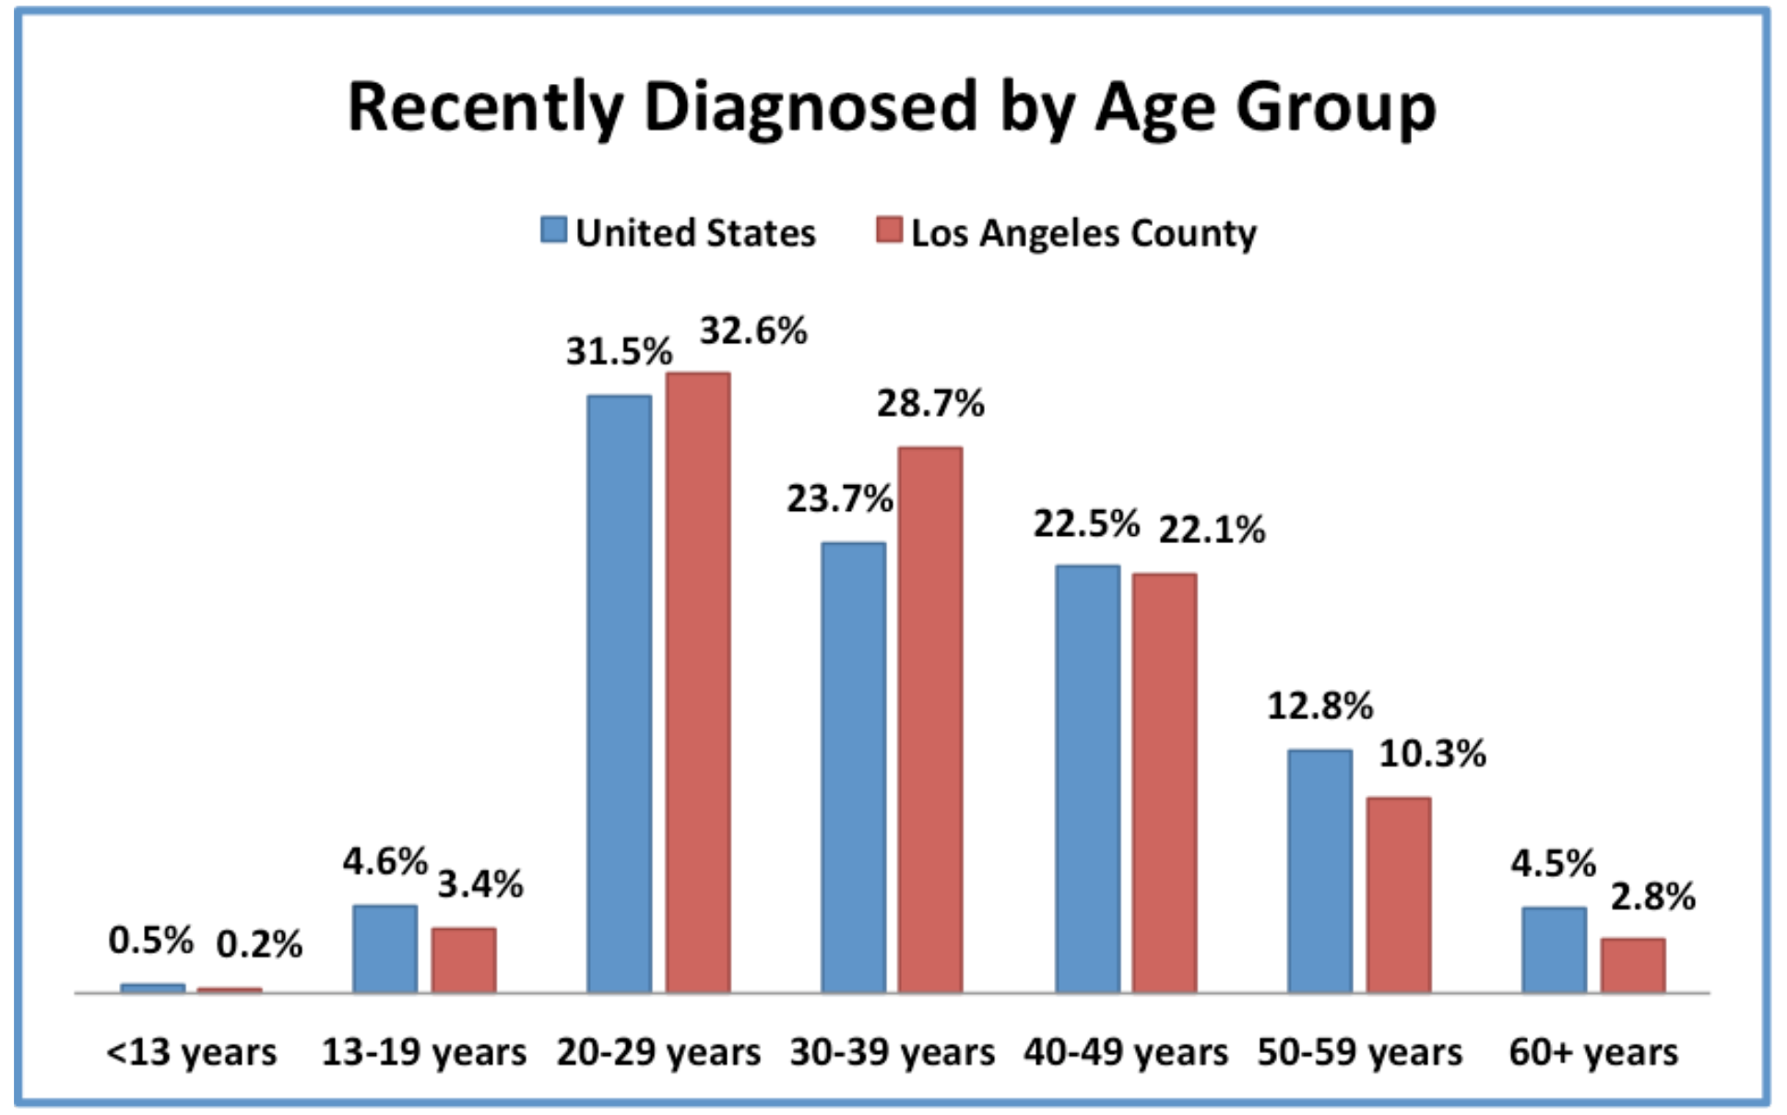
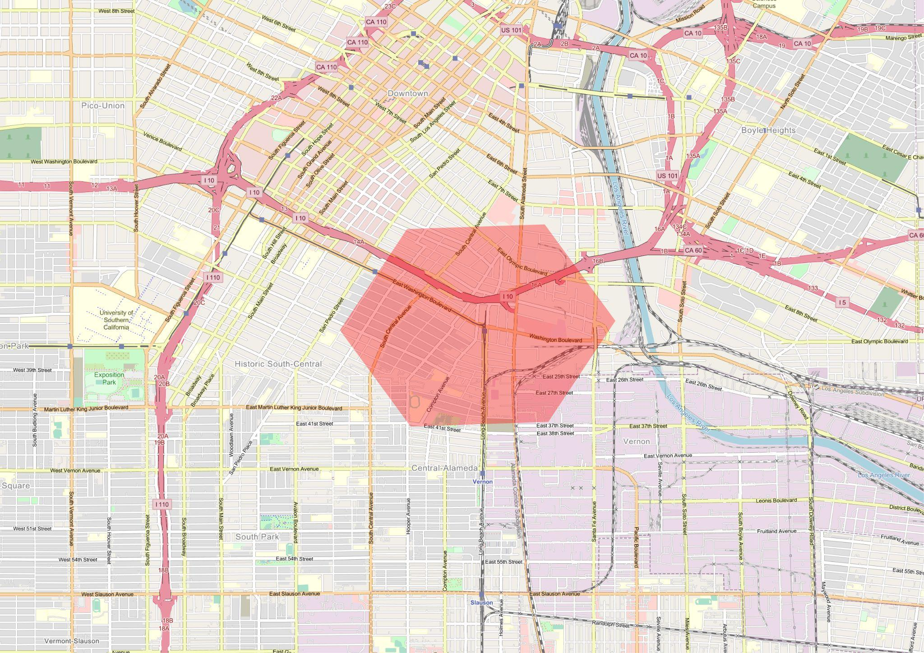
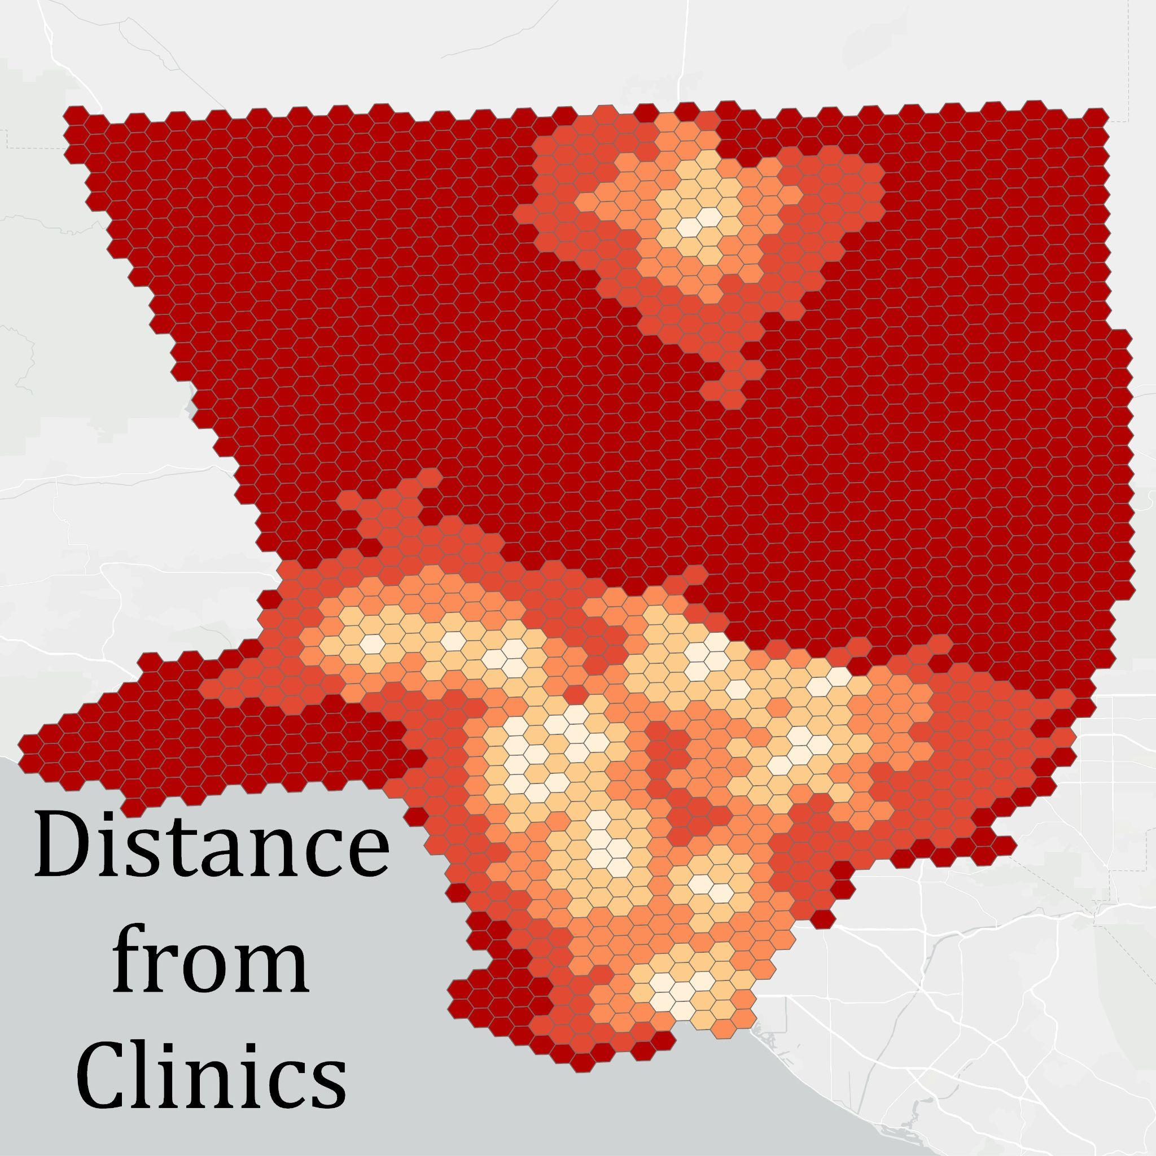
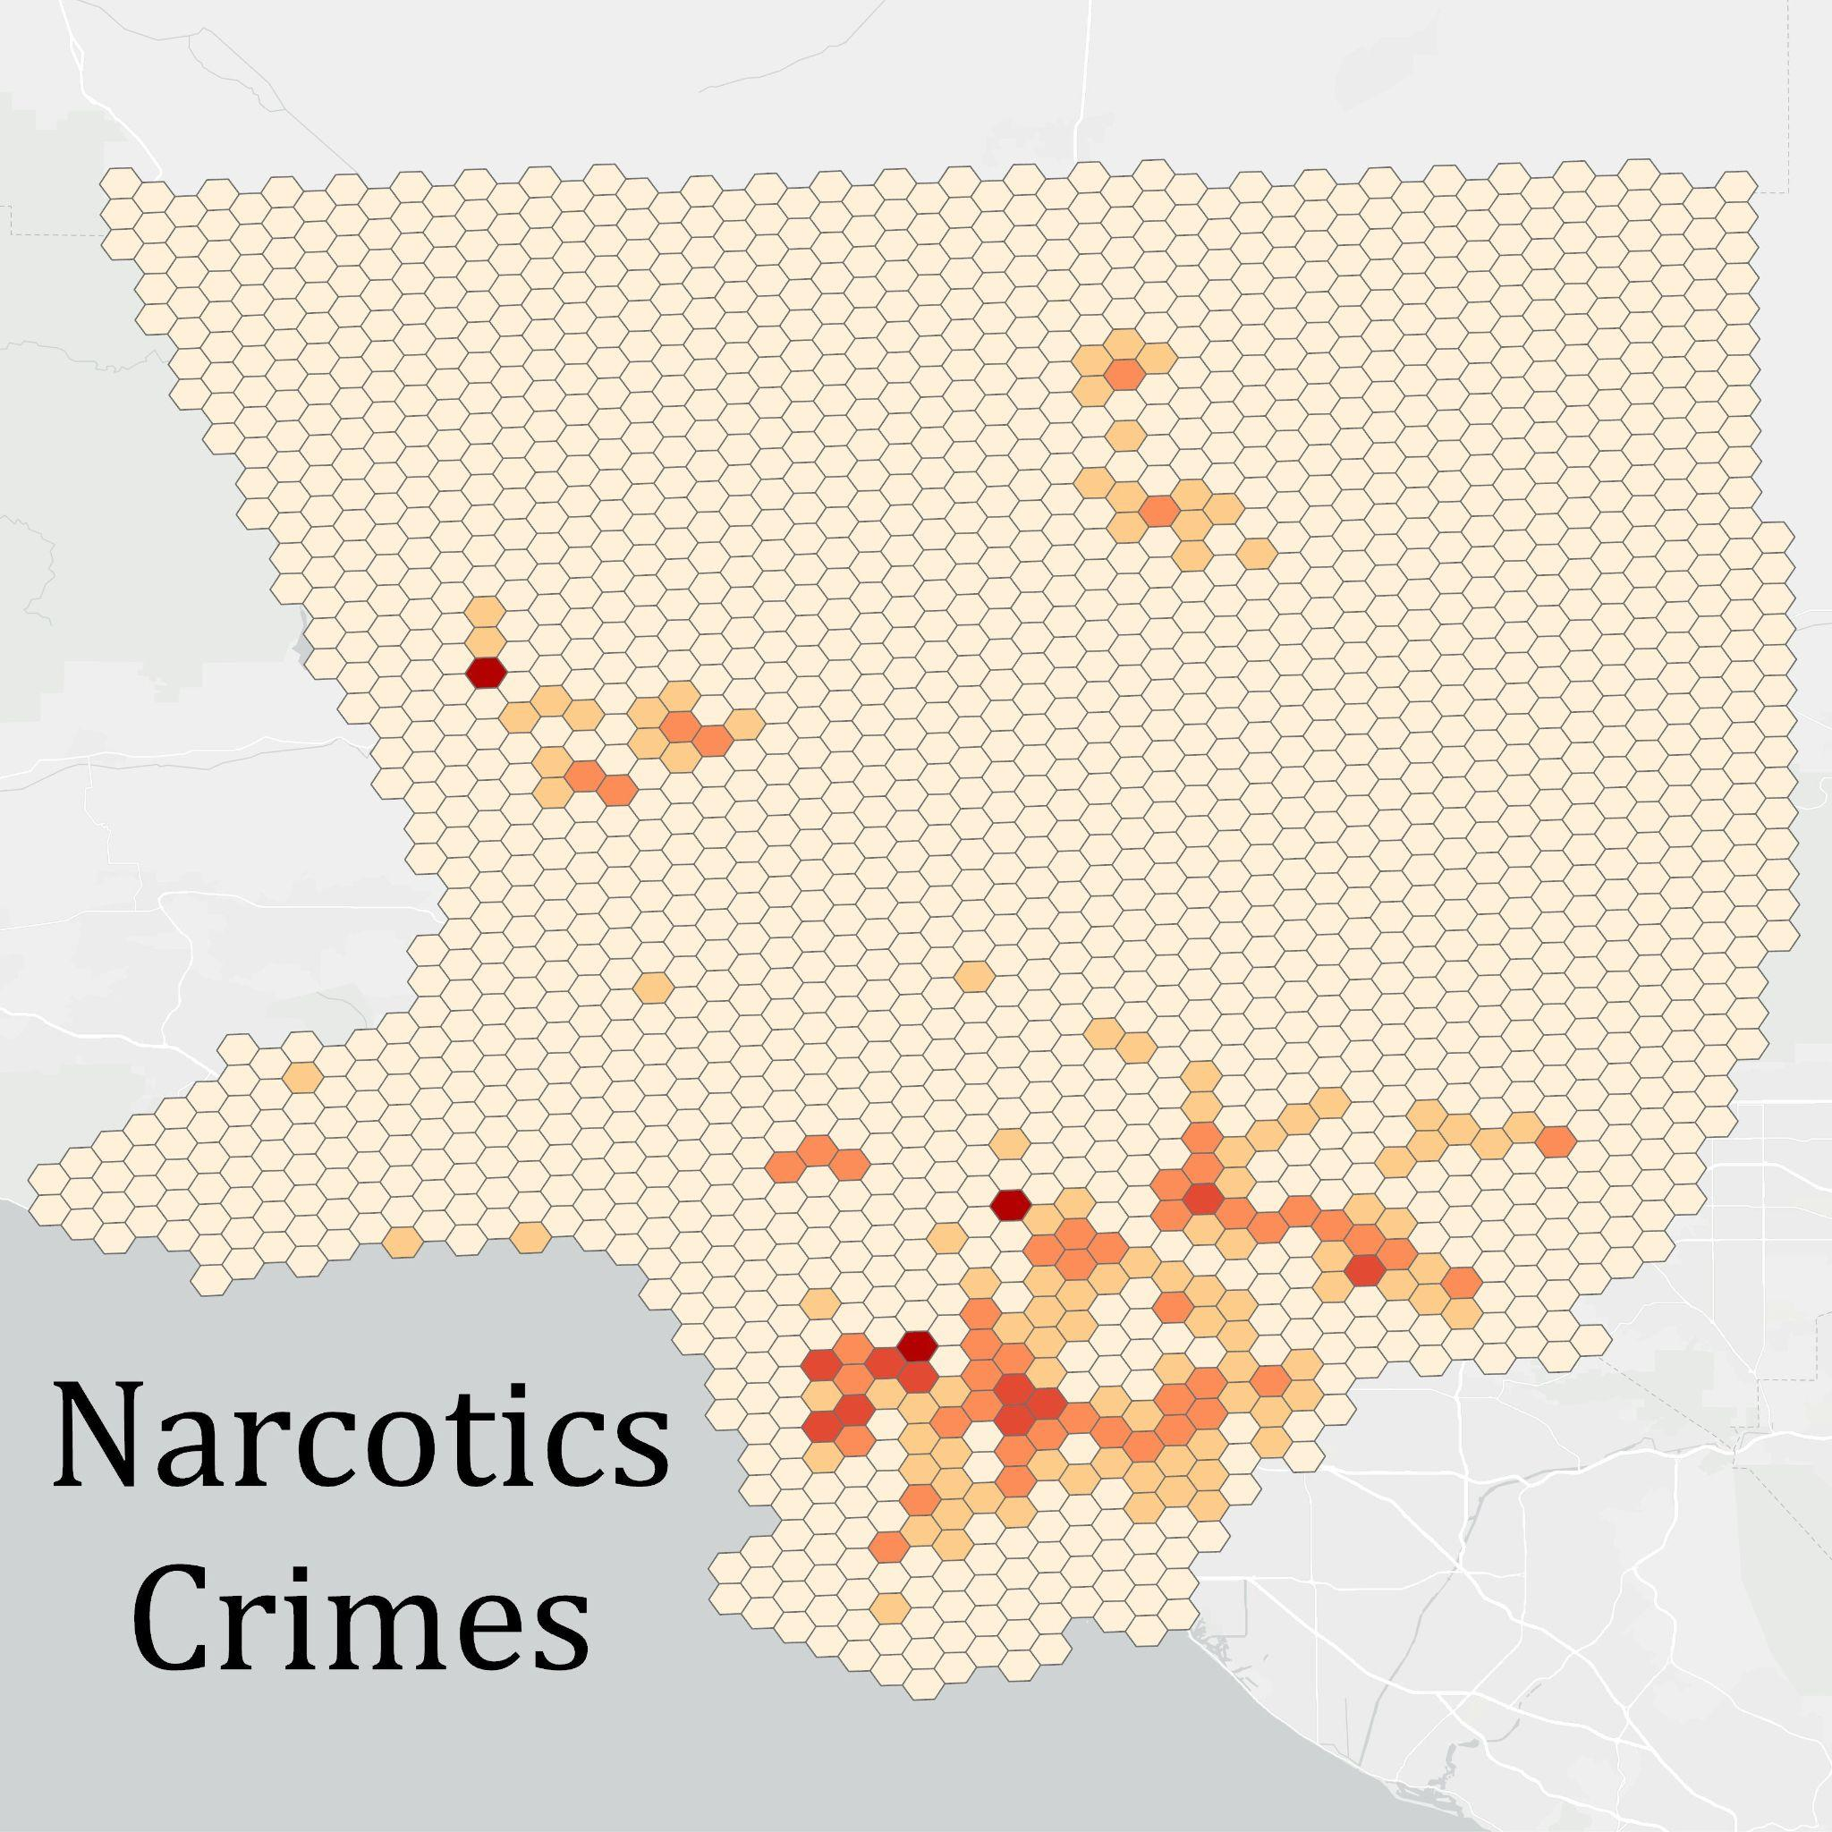
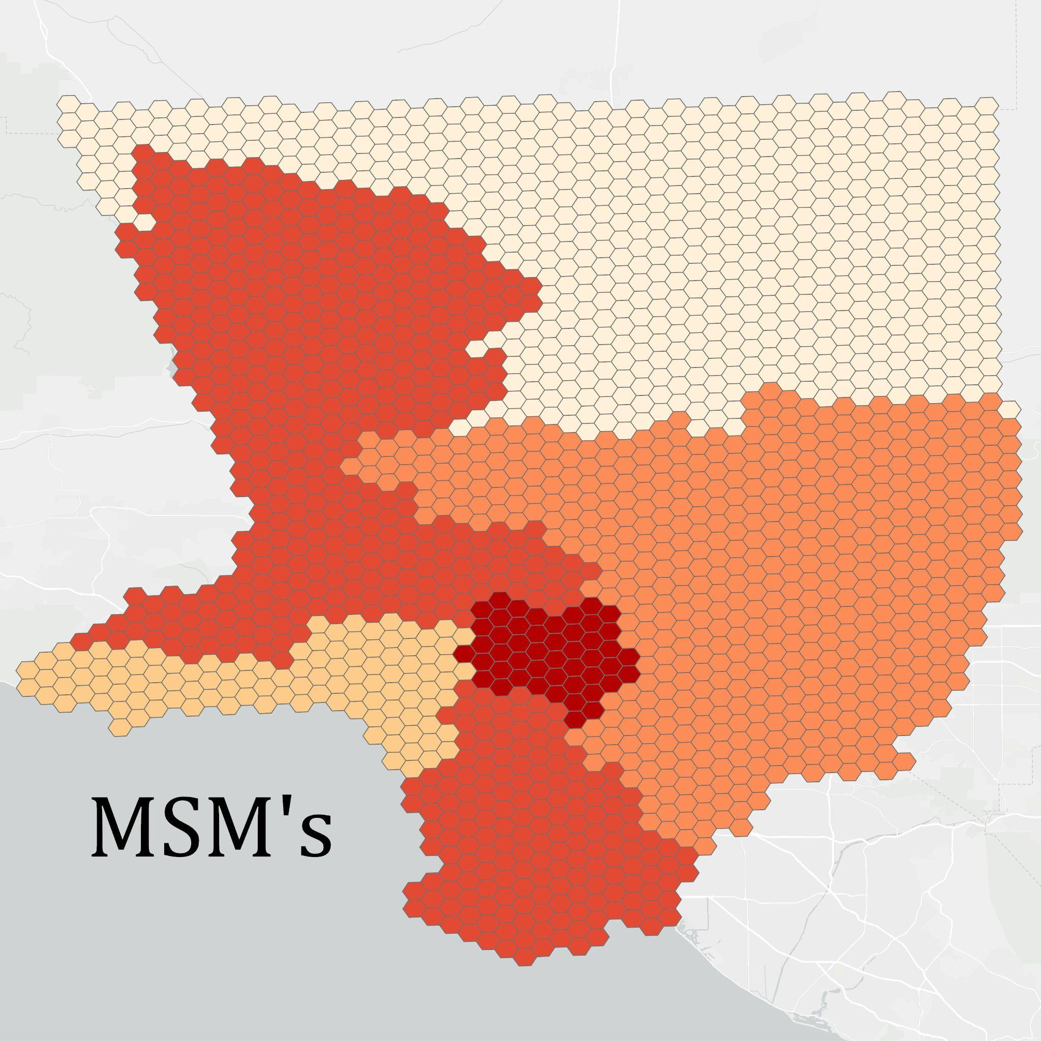
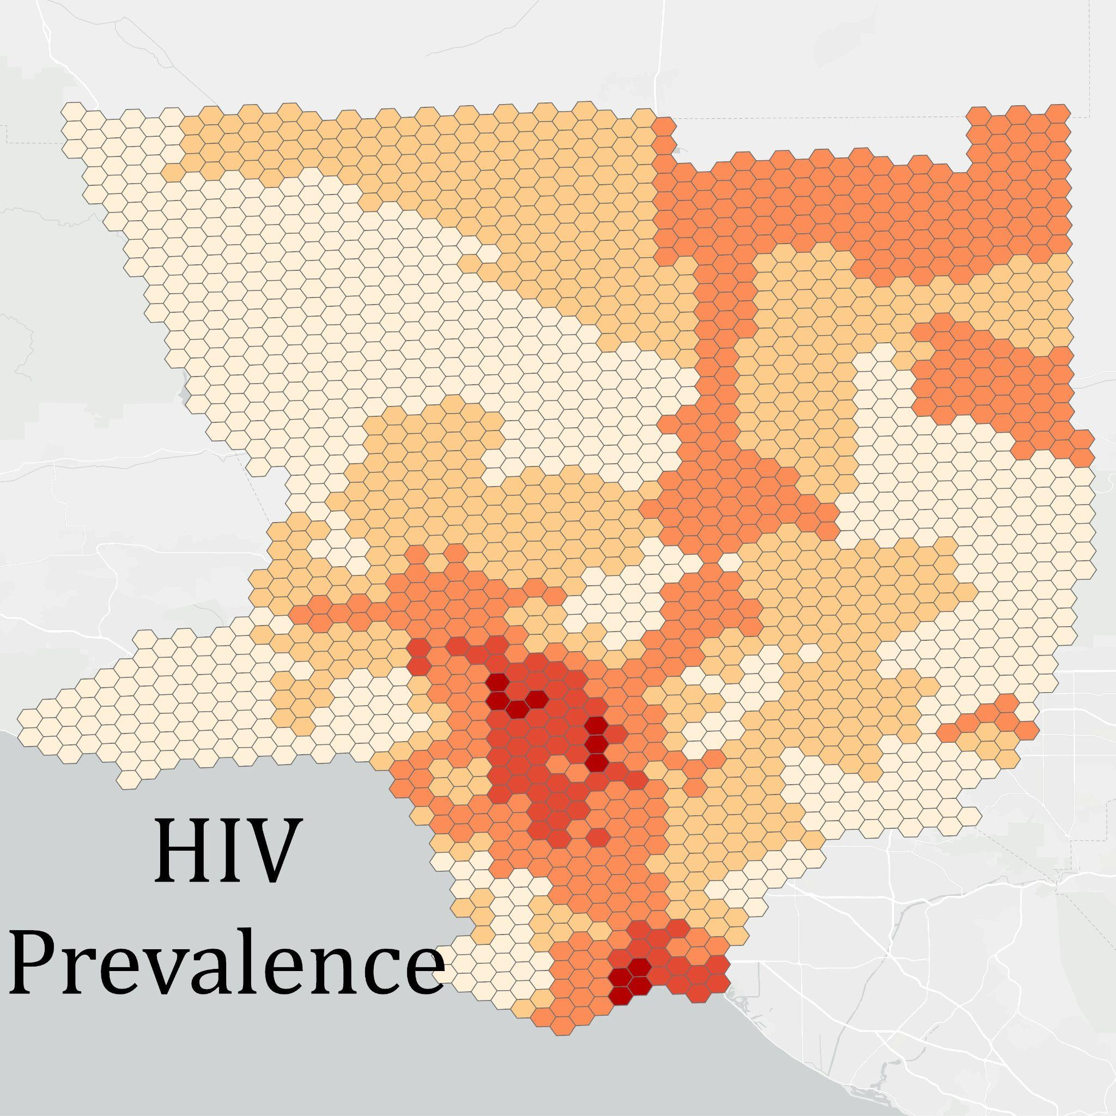
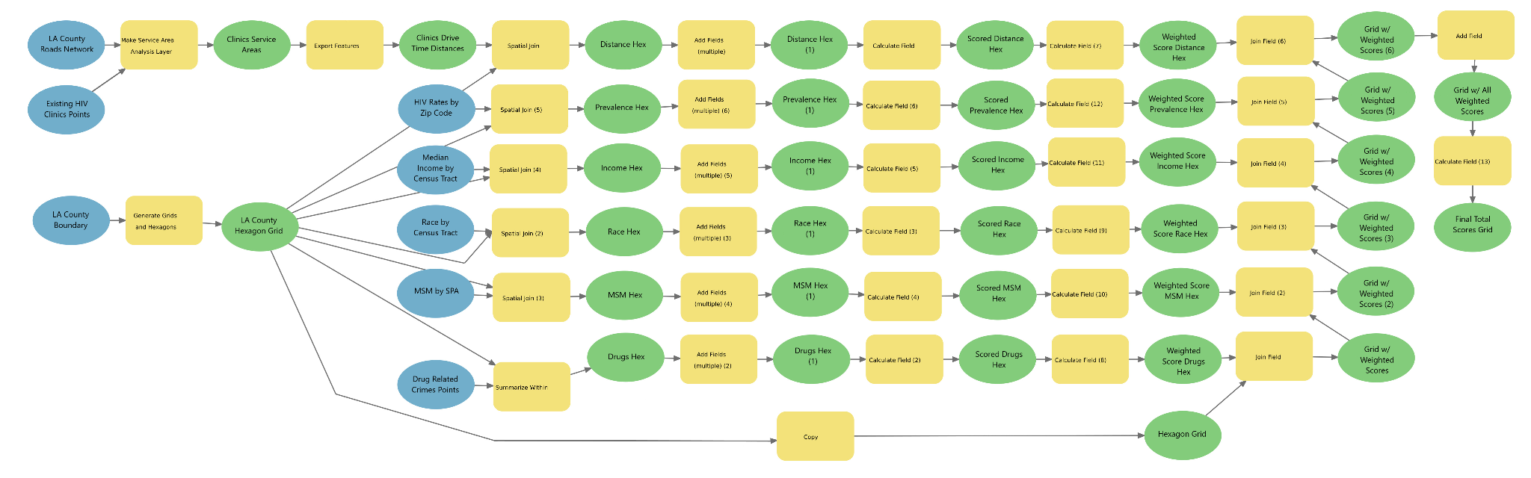
Suitability Analysis: Addressing HIV Treatment and Testing Needs in Los Angeles County
Elisabeth Bond, Damian Rhodes, Ava Marks, Hibah Ganie
University of California Santa Barbara, Department of Geography
Introduction
Methodology
Results
Conclusion
As of 2021, there were 602 people living with HIV in LA County per 100,000 people compared to the national rate of 385 per 100,000 people. Because of this, LA County is in a position where they need more HIV focused healthcare; in this project we focus on healthcare centers and clinics.
While HIV can infect anyone, certain groups are at higher risk of contraction. The most vulnerable included namely: minority racial status, low income, intravenous drug use, living in areas with high HIV prevalence, and MSM status (Male Having Sex with Males). This leads to our research question:
As shown in the workflow below, using a hexagon grid covering all of LA county, we used the Spatial Join tool with each of our input data layers to create a common spatial unit. From there, we created a scoring system for each layer with scores of 1-5. A score of 1 designated areas not indicative of our criteria (areas with low HIV rates for instance) and a score of 5 the opposite. Using these scores, we then applied our weighting scheme shown to the right and finally added together the weighted scores to reveal the areas within Los Angeles county that are most in need of a new HIV clinic.`
One hexagon with the highest suitability score of 4.01/5.00
Encompasses part of downtown LA and a portion of the Central Alameda neighborhood
Priority location for the establishment of a new HIV clinic
Part of a general cluster of hexagons with high scores
After conducting a comprehensive suitability analysis based on six spatial criteria—income, HIV rates, current HIV clinics, race, MSM’s, and intravenous drug use—we have successfully identified the most suitable area for a new HIV clinic in Los Angeles County. Utilizing a weighted hexagon grid approach, we pinpointed a specific hexagon with the highest vulnerability score. This area, situated within the downtown LA area, encapsulates the most vulnerable populations in need of HIV healthcare services. Our analysis emphasizes the urgent need to establish a new clinic in this location to address the existing healthcare disparities and cater to the specific needs of at-risk communities. By strategically pinpointing the area with the highest vulnerability, we aim to contribute to the enhancement of HIV/AIDS healthcare accessibility and provision in Los Angeles County.
Because our approach identified a generalized area of high vulnerability, further analysis could look at identifying a specific building suitable for use as a HIV clinic using criteria such as zoning, vacancy, proximity to other amenities, etc.
 | Narcotics Crimes | Race | Income | MSM | Clinic Proximity | HIV Prevalence
Weight | 0.05 | 0.09 | 0.13 | 0.20 | 0.23 | 0.30
Where is the most suitable area for a new HIV clinic based on vulnerability and historically disadvantaged areas using six spatial criteria: income, HIV rates, proximity to current HIV clinics, race, MSM’s, and intravenous drug use?
Data
HIV Clinics Point Layer: Manually created point layer using the addresses of existing HIV healthcare clinics. We defined existing HIV clinics using the locations listed on the LA County of Public health Department’s website. We’re looking to service areas far away from existing clinics.
HIV Rates Layer: The HIV rate for each zip code in LA County given by the number of cases per 100,000 people. Provided by LA County Public Health. We’re looking to service areas with high HIV rates.
Income Layer: The median household income for each census tract in LA County as provided by the LA County Geoportal. We’re looking to service areas with low median household income.
Race Layer: Percent non-Hispanic White for each census tract in LA County as provided by ArcGIS Online using census data. We’re looking to service areas with low rates of non-Hispanic Whites.
Narcotics Crimes Layer: Point locations for the locations of drug-related crimes arrests as provided by the LA County Sheriff's Department. We’re using drug-related crimes as a proxy for intravenous drug use and as such, we’re looking to service areas with high rates of drug-related crimes.
MSM’s Layer: Total number of HIV cases by MSM transmission for each LA County Service Planning Area as provided by the LA County Public Health Department. We’re looking to service areas with high amounts of these cases.
Data Sources
Data | File Format | Source
HIV Clinics | N/A | LA County Public Health
Narcotics Crimes | .shp | Los Angeles County Sheriff's Department
MSM | .pdf | LA County Public Health
Income | .shp | Los Angeles County Geoportal
HIV prevalence | .xlsx | AIDSVu
Race | .shp | ArcGIS Online
References
Los Angeles County Department of Public Health. 2022 Annual HIV Surveillance Report. 2022, http://publichealth.lacounty.gov/dhsp/Reports/HIV/Annual_HIV_Surveillance_Report_2022_LAC_Final.pdf.
Centers for Disease Control and Prevention. "HIV Risk Among Men Who Have Sex with Men." STD Treatment Guidelines, https://www.cdc.gov/std/treatment-guidelines/msm.htm#:~:text=HIV%20Risk%20Among%20Men%20Who,one%20in%20253%20(191).
World Health Organization. "HIV/AIDS." Fact Sheets, https://www.who.int/news-room/fact-sheets/detail/hiv-aids
Kavanaugh, Megan L., et al. "Meeting the Contraceptive Needs of Teens and Young Adults: Youth-Friendly and Long-Acting Reversible Contraceptive Services in US Family Planning Facilities." Perspectives on Sexual and Reproductive Health, vol. 44, no. 3, 2012, pp. 153-160, https://doi.org/10.1363/4412512
Acknowledgements
Many thanks to Dr. Peter Kedron and TAs, Danial Alizadeh, Sophia Kaloper and Yuyan Che for their guidance.

